Slide 1
The College Scholarship Training
March 14, 2024

Slide 2
Agenda
Helpful Links and Information
Important!
Exceptional Disbursement Process Review
2024-2025 Academic Year Award Timeline
Posting Deadlines
Spring and Summer 2024
Fall 2024 and Spring 2025
Award Amounts
Spring and Summer 2024
Fall 2024 and Spring 2025
Posting Process
Peoplesoft
Foundation Workday Supplier Invoice Request
Information, Attachments, Process
Recipient Process
Follow Up
Common Error Messages
Scholarship Tracking Template
Questions?

Slide 3
Helpful Links and Information
The College Foundation and Scholarships Resource page https://hrfinance.thecollege.asu.edu/budget-and-finance/scholarships
Financial Aid Scholarship Administrators Website Scholarship Administrators Resources page
Scholarship Posting Users Guide DSP User Guide
Requesting Distributed Scholarship Poster Access: Requesting DSP Access. Once you have completed DSP training (Career Edge, “Browse Training” search for “DSP User Training”) and PeopleSoft access is granted, email Rebecca Magaña with your ASUrite and the posting access level required.
Level 1 – This access level is given to the person(s) that will enter scholarship awards.
Level 2 – This access level is given to the person(s) that will complete the first review and award approval.
Decision – This access level allows users to pull application data for scholarships submitted via the ASU Scholarship Portal (see Portal Application Data Pull Procedures in DSP guide for more information).
To request access to ASU Foundation Workday:
The Gift Financial Analyst Role can now be requested here: https://asuep-563184.workflowcloud.com/forms/a3c3e35c-f7d6-4726-87a8-beba44e23d24
Gift Financial Analyst Role – Can view accounts and enter transactions. This is the only role that will be approved at a School level.
The supervisor can enter the request into ASUF and forward the docusign link for the Database User Agreement to the new employee. (copy and paste into an email) once new employee completes the docusign, it will move the request on for approval.
Provide her with: This is done by HR code, i.e. Dean’s Office is B1701, or specific account code if only a few needed.
New Item Type Request form: Request for New Scholarship Item Type. List Rebecca Magaña as Primary Contact Email.
Scholarship Balance Report in ASU Workday. Request access here if needed.
Financial Services Stipend Guide. This guide helps ASU departments determine whether to process a stipend payment through the financial management system, student financial system, or payroll system.

Slide 4
Helpful Links and Information continued
Taxability of Scholarships.
Scholarship Application Posting Best Practice. If posting to the application portal for endowed scholarships, always check gift agreement to verify amounts, criteria, etc. If you are uncertain about the amount you will have to award in the upcoming cycle, you can use phrases like “award will be at least $X” or “award amount can be up to $Y.”
As a reminder, federally funded awards cannot be applied to past due balances. Private scholarships will.

Slide 5
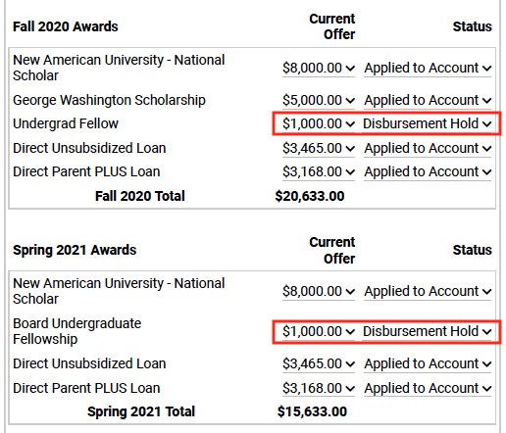
Helpful Links and Information continued
The reason we enter awards on this timeline is to assist with better student outcomes. The earlier student financial aid has award information, the better they can advise students on the need for additional loans, amounts due, etc. Accurately knowing how much they will owe in upcoming semesters encourages student enrollment.
Example: Student obtained Fall and Spring loans based on amount they thought would be received in scholarships. Loan amounts brought student to cost of attendance award limits. Student then received Fall and Spring scholarship awards during the spring semester which were unable to be disbursed.
While we can process awards throughout the academic year, try to avoid these situations.
When scholarships are disbursed to a student account, the funds first pay anything owed to ASU. Any remaining amount is then refunded to the student.
Scholarships are not intended to connect to specific student expenses or be compensatory. You can refer to the stipend guide for more information.

Slide 6
Important!
All the student financial aid policies we follow are federally mandated. If ASU fails to do this for even one scholarship, we could lose the ability to process ANY scholarships.
Student Privacy
ASU employees cannot select recipients for scholarships that include a preference for protected classes. This includes race, gender, ethnicity, country of origin, religion, and disability.
For these awards, ASU Foundation employees in your unit or The College development team can make the final selection from the finalist pool.
Student IDs and other sensitive information should be removed from review documents
Financial need information should not be shared with external reviewers.
Privacy should be emphasized to reviewers and conflicts of interest should be avoided.
Non-Degree Students
If you award a scholarship to a non-degree student, the scholarship office must manually award these. Please let Rebecca Magaña know if this is the case with any of your awards.
Exceptional Disbursements
If you enter an exceptional disbursement, be aware these are completed manually by the scholarship office. They generally take 3-5 business days and are usually processed Tuesdays and Thursdays.

Slide 7
Exceptional Disbursement
Scholarship Administration implemented an additional step for entering exceptional disbursement awards last year.
After submitting exceptional disbursement justification, click the plus sign [+] in line with Effective Date. This will
give the new award an effective date stamp with today’s date.
Finally, click the Lock Proration box next to the term of the exceptional disbursement:
Scroll to the bottom of the page and hit Save.
This process allows scholarship to “Post” to student’s account but will still require Manual Disbursement by Scholarship Staff
Allow 5 days for processing once entered; longer at peak times (such as fall/spring start)
Scholarship will continue to display $0 until manually disbursed

Slide 8
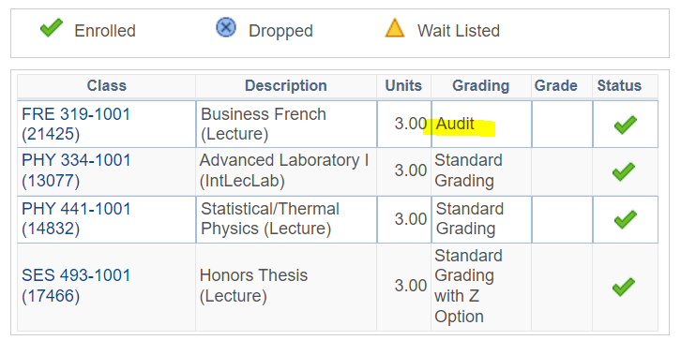
Exceptional Disbursement Continued
Be aware of audit credits when reviewing student enrollment.
Total shows as 12 credits, but the 3 audit credits don’t count toward enrollment and still would require the exceptional disbursement process.

Slide 9
2024-2025 Academic Year Award Timeline
Late February- Mid March – Check foundation endowment account payouts, current available balance in endowed and non-endowed accounts used for scholarships, and ASU Workday item type balance report.
April 1 – Deadline for scholarship selection
April 10– Student award notifications, terms of agreement, thank you letters, etc.
April 26 – Deadline for Spring 2024 award posting and funding transfer requests
April 30 – Deadline to send student award notifications, receive signed terms of agreement, donor thank you letters, etc.
May 6 – Date you can begin submitting Summer 2024/Fall 2024/Spring 2025 non-endowed account only funding transfer requests.
May 20 – Date you can begin submitting Fall 2024/Spring 2025 endowed account transfer requests. We have been asked by ASUF not to submit endowed payout funded requests prior to this.
** Hold for FY25 Payout in comments and in the Supplier Invoice Number reference FY25 Payout **
May 31 – Deadline to post Fall 2024/Spring 2025 awards in peoplesoft and submit funding transfer requests.
June 3 – Deadline to post Summer 2024 awards in peoplesoft and submit funding transfer requests
Mid-July – Endowment payouts process and funds transfer to item types
Early August – Scholarship disbursement per Student Financial Aid timelines
Mid-late August – Check scholarship detail reports and correct errors

Slide 10
Posting Deadlines
Spring and Summer 2024
Post these awards as soon as possible.
Spring awards must be posted in PeopleSoft and funding transfers requested by April 26th prior to the end of the semester.
Summer awards must be posted in PeopleSoft and funding transfers requested by June 3rd.
In the Supplier Invoice Field in the SIR header, include the award term, i.e., Spring 24, Summer 24, Fall 24/Spring 25, Spring 25.
Fall 2024 and Spring 2025
Friday, May 31st- To allow time for College level review and approval, please have Fall 2024 and Spring 2025 scholarship awards posted in PeopleSoft and funding transfers requested by this date. ASUF has requested we not post these before May 20th.
Please request any exceptions to this deadline as soon as possible by emailing Rebecca Magaña.
In the Supplier Invoice Field in the SIR header, include the award term, i.e. Spring 24, Summer 24, Fall 24/Spring 25, Spring 25.
If you are requesting an amount less than the full payout balance, include the reason in the internal memo field at the bottom of the SIR.

Slide 11
Scholarship Award Amounts
The amounts to be given to students should be decided prior to advertising the scholarship. The award amount must consider:
Endowment Agreement scholarship criteria for specific funding requirements (Fall/Spring, dollar amounts, reinvestment, etc.).
Funds available for upcoming cycle (see details below).
You may need to discuss the amount with your Director or other unit administrator – particularly if award amount is significantly different from the previous year, or if there is a large balance in the ASU Foundation spending account (FD320).
Awards must be in full dollar amounts (no cents).
In the Supplier Invoice Field in the SIR header, include the award term, i.e. Spring 24, Summer 24, Fall 24/Spring 25, Spring 25.
If you are requesting an amount less than the full payout balance, include the reason in the internal memo field at the bottom of the SIR.
NOTE: If the total available balance in the foundation gift account is significantly more than the award amount stated in the endowment agreement, check the agreement to see if there is guidance regarding this possibility. If not, please work with your Director and Development team to determine an appropriate amount. You should be awarding ALL AVAILABLE FUNDS from endowed FD320 accounts.

Slide 12
To calculate Spring and Summer 2024 awards
Check current balance in the Item Type in ASU Workday:
Run the Scholarship Balance Report in ASU Workday. Request access here if needed.
Open Scholarship Balance Report, found under Department Reports.
In Worktag field, enter Item Type (must include GF in front of Item Type).
Ending Balance After Reserve will show available funds. This does not consider funds awarded but not yet disbursed.
Check available/spendable cash balance in the ASU Foundation account using the Gift Inquiry report in ASU Foundation Workday.

Slide 13
Scholarship Balance Report
Ending Balance After Reserve will show available funds. This does not consider funds awarded but not yet disbursed.

Slide 14
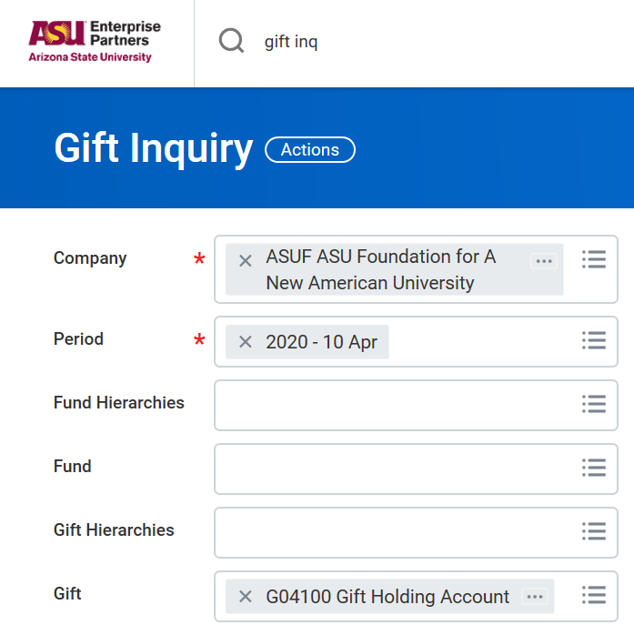
Gift Inquiry
Report displays gift name, attributes, and cash balance, as well as gift value and market value for endowed accounts.
Company default is ASU Foundation
Period Selections
Default is Current Period
Current Period = detail through current date
Prior Period = last date of previous month
All Periods to search prior fiscal years
Can search by:
Gift, i.e. G02392. Can enter one or multiple
Gift Hierarchy, i.e. B1701, to see all accounts
Can limit search to specific Fund if needed
Click OK

Slide 15
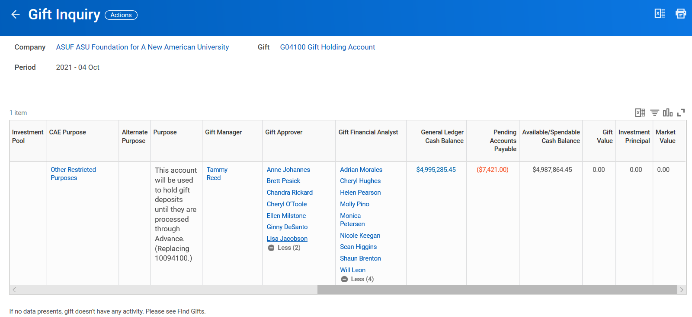
Gift Inquiry (Continued)
Report Display
Any blue text is a link to additional information. Names show account access levels.
General Ledger Cash Balance does not include pending Accounts Payable transactions
Available/Spendable Cash Balance = funds available to spend
Report can be exported to Excel or saved in PDF format using the Icons to the far right in the header. This is true of all reports.

Slide 16
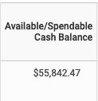
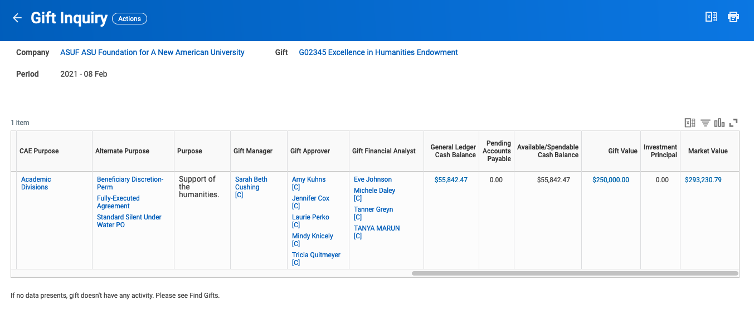
Gift Inquiry (Continued)
Endowment Account Report Display
Available/Spendable Cash Balance = funds available to spend
Gift Value shows total donation. If less than $25,000, account generally will not have a payout.

Slide 17
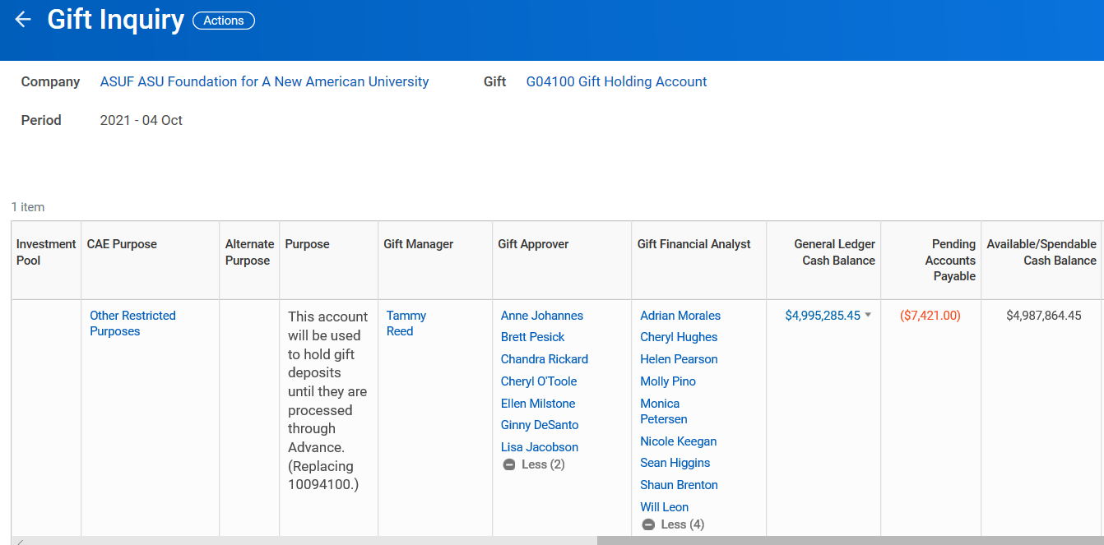
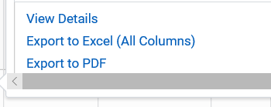
Gift Inquiry (Continued)
Select the downward triangle for additional details and options

Slide 18
To calculate Fall 2024 and Spring 2025 awards
Check current balance in the Item Type by running the ASU Workday Scholarship Balance Report.
For non-endowed scholarships (FD300) run Gift Inquiry report in ASU Foundation Workday to check available/spendable cash balance in the ASU Foundation account.
For endowed scholarships (FD320), use the Summary Balance Sheet and Income Statement report in ASU Foundation Workday to check the July 1, 2024 payout amount.
The FY25/July 1, 2024 payout amount should be available now on the summary balance sheet report. It is listed in the row “other investment change” under the FD320 column.
Use prior year payout as an approximation if accrued payout amount is not yet listed.
The total available to award is the available/spendable cash balance PLUS the FY24 Endowment payout PLUS any remaining amount in the scholarship item type. As a reminder, any funds listed as pledges receivable DO NOT COUNT TOWARD THIS TOTAL.

Slide 19
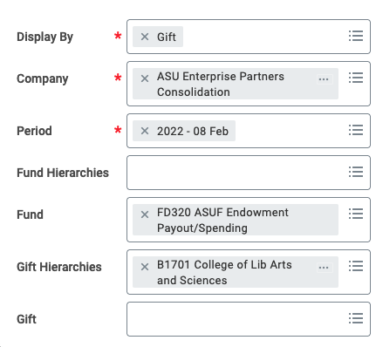
Summary Balance Sheet and Income Statement by Gift/Fund
Select Display By Gift
Company Default = ASU Enterprise Partners Consolidation
Period Selections
Default is Current Period
Current Period = detail through current date
Prior Period = last date of previous month
All periods to search prior fiscal years
Can search by:
Gift, i.e. G02392. Can enter one or multiple
Gift Hierarchy, i.e. B1701, to see all accounts
If you only want to see payout amounts, select FD320 in fund
Click OK
Report details shown on next slide

Slide 20
Summary Balance Sheet and Income Statement by Gift/Fund (con’t.)
Balance Sheet Details
blue text is a link to additional information
In FD320 column
Available cash = current funds in account
Does not include pending AP transactions
Other investment change = July 1 payout amount
Those together = amount available to award
Report can be exported to Excel or saved in PDF format using the Icons to the far right in the header.

Slide 21
Scholarship Posting Process
For awards to be approved, the following two items must be completed.
No awards will be reviewed or approved without them.
Post PeopleSoft award: includes student name, ASU ID, dollar amount for each term. Complete the ‘IFAS Account’ field with: ASU Foundation Workday Gift account number or ASU Workday Program/Grant/Gift account number.
Submit Funding Transfer Requests:
For ASU Foundation account funds, process a Supplier Invoice Request to the ASU Scholarship Office.
All memo fields must have GF followed by 12-digit scholarship item type. This means the memo field in the header and service line(s).
Email to Rebecca Magaña, as a separate PDF per scholarship (include unit name in subject):
Name the PDF as: SIR#_unit_scholarship name, i.e., SIR-005672_SCETL_Cook Undergrad
A PDF of the Workday Scholarship Disbursement SIR document
A PDF of the Summary Balance Sheet and Income Statement report (only if requesting endowment payout funds Fall 2024/Spring 2025)
A PDF of the Gift Inquiry report
A PDF of the scholarship item type balance report if using remaining funds
These should be combined into one pdf per SIR in the above order. You do not need to send a separate email for each SIR. You can process and send all at once.
If Summary Balance sheet shows a payout, transfers can be requested for Fall 2024/Spring 2025 awards.
For ASU Endowment accounts (FD340), NO Workday transfer SIR is needed but you must provide a pdf of the Summary Balance Sheet/Income Statement to verify amount availability (ASU completes transfer).
B. For funds from your department's ASU Workday CC/Program:
Email ScholarshipTransferRequest@exchange.asu.edu with your ASU Workday Cost Center and Program/Gift to request a transfer of funds to the appropriate Item Type. Copy Rebecca Magaña on this email.

Slide 22
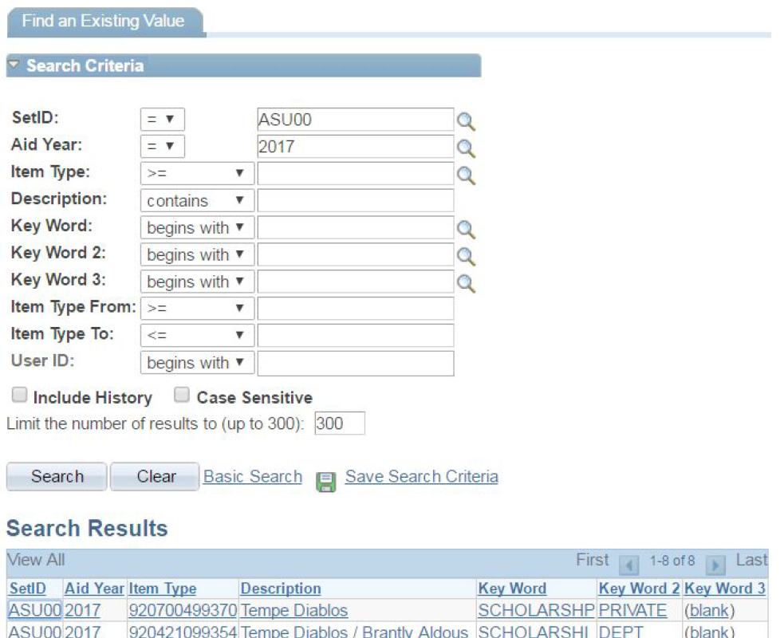
Enter Award in PeopleSoft
Main Menu > ASU Customizations > ASU Financial Aid > Scholarships > Distributed Scholarships > Enter Scholarship Awards
Enter any values in the fields to narrow the search criteria. Leaving all fields blank will return all item types that the user has authorization to access.
Be sure to include the appropriate Aid Year (ex: 2025 for the 2024-25 academic year).
Click ​“Search,”​ and select one of the item types from the search results

Slide 23
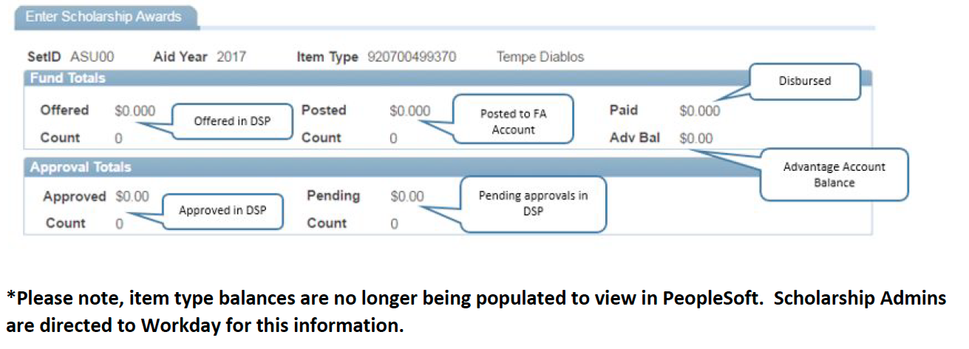
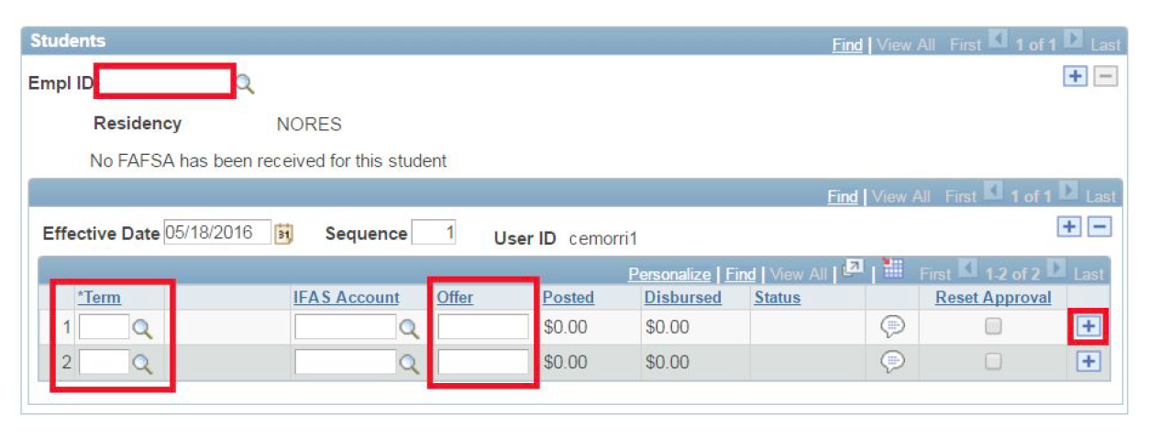
From the Enter Scholarship Awards screen, you can view information about the scholarship item type, such as
the offered, posted, and paid scholarship amounts for the year. “Count” gives the total number of students with
awards offered and posted. The approvals totals sections gives the amount approved and pending approval.
*Please note, item type balances may be populated in PeopleSoft, but are not always correct. Verify balances using the ASU Workday scholarship item type report for this information.

Slide 24
Supplier Invoice Requests
When entering lines for supplier invoice requests, enter the gift account FIRST! This will auto-fill cost center, fund, and program. All lines in supplier invoice requests must be entered as service.
The gift account is G plus 5 digits, e.g., G06567. Accounts entered in supplier invoice requests should default to the spending account (FD300 or FD320). Verify this by checking the fund code. It will be FD320 ASUF Endowment Payout/Spending for endowed accounts or FD300 Spendable Gifts-Temporarily Restricted for non-endowed.
For all supplier invoice requests, you can enter multiple service lines IF AND ONLY IF the information in the header/memo field is the same for each. This can be used to reimburse someone or request funding disbursements from multiple accounts to the same item type or ASU Gift account.
The more information you include in the memo/attachments, the easier it is for ASUF to assist if you’ve made a mistake.
When you submit, send an email to Rebecca Magaña with the following:
SIR# in the subject line or Unit Name Award Year Scholarships, a pdf of the SIR document(s) (named as – SIR#_unit name_scholarship name), a pdf of the gift inquiry page, a pdf of the Summary Balance Sheet and Income Statement page (if required), and a pdf of the scholarship item type balance report (if using existing funds). These should be combined into one pdf per SIR#.

Slide 25
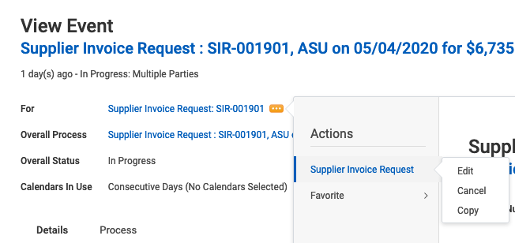
To Edit a Supplier Invoice Request
If you know you have made a mistake and need to edit a document, you can do so by navigating to your ASU Foundation Workday inbox, click archive, and select the SIR. Once you’re in the SIR, you click the … next to the “for” line and then supplier invoice request-> edit. See below for example.

Slide 26
Sending Funds to ASU Scholarship Office
Create Supplier Invoice Request (SIR)
Populating Invoice Template
Enter Invoice date if needed
If not use default
Invoice Received Date (N/A)
Not required or needed
Company = ASUF
Supplier = ASU Scholarship Office
Currency defaults
Control Total = Invoice Amount
Enter Invoice Number
Scholarship name/term
Add attachments if needed
Address defaults
Payment Term defaults
Enter Memo Details which must be:
ASU Item Type #
Must put GF in front

Slide 27
Sending Funds to Scholarship Office (continued)
Complete Lines Tab
Must Select Services
Enter Spend Category – Scholarships = SC7100
Enter Extended Amount (total must equal Control Total amount)
Enter Gift Number First
If Gift is entered = Cost Center, Fund and Program default
All spend on ASU Foundation Gifts = (Program PG0003)
Enter same scholarship information (GF/Item Type) information in internal memo field.
Complete Attachments Tab
Enter attachment(s) to support transaction if required
Click Submit - system assigns SIR#
Routes request through BP for needed approvals
Jot down SIR#
for future reference

Slide 28
Information, attachments, process:
Sending Funds to Scholarship Office
In the memo field, enter the scholarship item type in required format. This is GF + the item type. Add attachments if needed. When you submit, send an email to Rebecca Magaña with the SIR# in the subject line, a pdf of the SIR document (named as – SIR#_unit name_scholarship name), a pdf of the gift inquiry page, and a pdf of the Summary Balance Sheet and Income Statement (if needed). These should be combined into one pdf per SIR#.
To obtain scholarship approval you must:
Submit the award in PeopleSoft
Process at least one of the following:
Request the funds via Supplier Invoice Request
Send the required SIR documents to Rebecca Magaña
Request the funds by emailing Scholarship Transfer
Copy Rebecca Magaña on this email
SCHOLARSHIPS WILL NOT BE APPROVED UNTIL FUNDING IS VERIFIED AND AWARD IS MATCHED IN PEOPLESOFT.

Slide 29
Scholarship Recipient Process
Scholarship recipients should be notified prior to the award being posted in PeopleSoft
All scholarship recipients must submit a ‘Terms of Agreement.’ Completed ‘Terms of Agreement’ should be kept on file in the academic unit.
All scholarship recipients should submit a ‘thank you letter.’ Recipient thank you letters should be sent to the applicable College Development Officer who will share them with the donor.

Slide 30
Scholarship Posting Follow Up
Assuming the item type has been funded, scholarships are disbursed 7-10 days before the beginning of the term/or class start date if dynamic class.
Regularly check to ensure that funds have been transferred and disbursed. At a minimum it is recommended that you check on the 1st day of classes each semester. You should also check mid-way or at the end of the semester if additional awards have been posted. To do this, you can use the Scholarship Detail report in PeopleSoft to verify awards have been disbursed to students. Instructions for this report are in the DSP User Guide.
If an award has not disbursed, you need to investigate and resolve any problems. The most common reasons for this are:
Insufficient funds in the item type.
If the full amount of a funding transfer is not available in the item type, this may be the result of a 5% unrestricted fee error. You can check for this using the Scholarship Balance Report in ASU Workday. If you discover a 5% unrestricted fee charged to an Item Type, send an e-mail to Scholarship Transfer Request, and someone will research and work to correct the issue.
Student not enrolled during award term. Student must be enrolled in at least one credit hour during award period.
Student enrolled fewer hours than item type requires. If this is the case, and you would like to justify the award, you can process an exceptional disbursement. Don’t forget to check if any audit credits.
Any problems, contact Rebecca first, NOT the scholarship office.

Slide 31
Common Error Messages
Message | Action to Resolve
Student’s Attempted Units on the FA Term fall below the minimum for this term | Enter an Exceptional Disbursement Request, if applicable
Insufficient Funds for this Disbursement | Review item type balance, and process a transfer request according to type of account
Enrollment Data Does Not Exist for this student | Review Enrollment; if not enrolled cancel award; if non-degree contact Scholarship Services
One or more User Edits exist for Student. E-D00004 | Citizenship; student needs to work with Registrar to resolve hold to confirm eligibility for posted award
The Student has one or more User defined 'Action Codes'. E-D00024 | Overaward; allow 5-7 days for overaward review; if posting is outside this timeframe, contact Scholarship Services

Slide 32
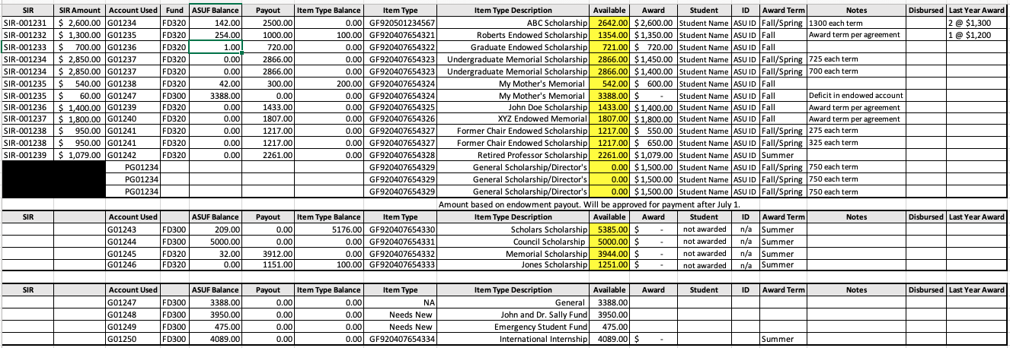
Scholarship Tracking Template - Optional
Can be used to track students, amounts, balances, changes year over year, etc.

Slide 33
Questions?
ASU Foundation Contact Information
ASU Foundation Email: foundation.financial.services@asu.edu or ffsmail@asu.edu
ASU Foundation Finance hotline: 480-965-7825 or 480-965-7850
ASU EP Workday Email: workday@asuep.org or servicecenter@asuep.org
ASU EP Workday Help Desk: 480-965-7445
The College Liaison: Rebecca Magaña, The College Dean’s Office, rebecca.magana@asu.edu, 480-727-4602
Office Hours 7am – 4pm – Remote Monday & Wednesday

