Slide 1
Procurement Process
"How to buy stuff”
Tyler French Associate Director, Strategic Partnerships
Supply Chain Tyler.French@asu.edu

Slide 2
Who We Are
Bailey Nazifi – Sr. Procurement Specialist
Douglas Feckovics – Sr. Procurement Specialist
Alvaro Marcelino Hernandez – Procurement Specialist
Diana Doty – Procurement Specialist
Richard Mancha – Procurement Specialist
Timothy Wright – Procurement Specialist
https://cfo.asu.edu/procurement

Slide 3
Agenda
Definitions
Informal vs. Formal
Dollar Value Thresholds
Federal Purchases
Thinking Through a Purchase
Purchase Orders & Contracts
Procurement in Practice
Questions

Slide 4
Definitions
ABOR – Arizona Board of Regents
RFP – Request for Proposal and/or Really Fun Procurement
ITB or RFB – Invitation to Bid, Request for Bid
Requisition – Request to buy something. Initiated by the department.
Purchase Order(PO) – Binding contract once issued. Or payment vehicle if governed by negotiated agreement.
Negotiated Agreement – Set of negotiated terms that govern an obligation.
Procurement Method – How we document we’ve met competitive requirements.
Payment Method – How we pay for something. Pcard or a PO.

Slide 5
Informal vs. Formal
Informal
Under $100k
Overseen by Department
Competition is validated by procurement
Multiple quotes or explanation why not
Goal: Determine the price is fair & reasonable
Formal
Over $100k
Overseen by Procurement
Process is guided by Procurement
Bidders are evaluated based on criteria
Goals: Award based on criteria
We look at the totality and intent of the agreement.
A $25k annual PO to a landscaper is informal.
A 5 year agreement with that same landscaper totals $125k and is formal.

Slide 6
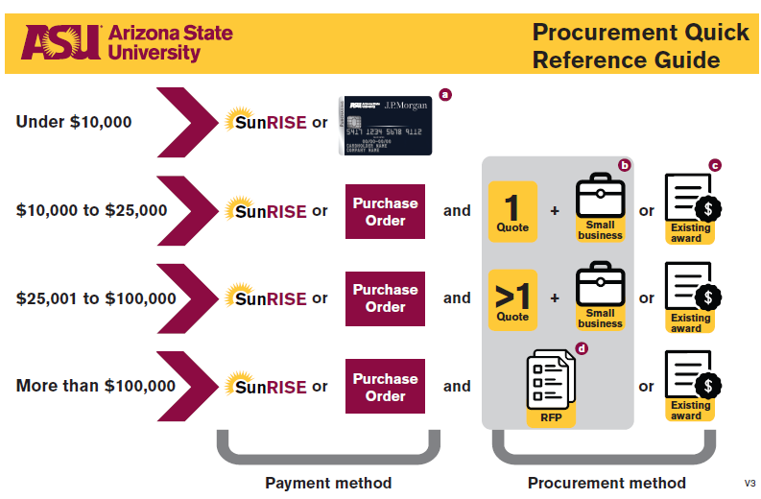
Dollar Value Thresholds
Under $25k = Department Threshold
You validate source selection
Between $25,001-$100,000
Just paint the picture for us.
Over $100,000
We need to:
Use an existing ASU Award
Conduct a new RFP/B
Identify an external RFP (procurement method)
Sole source justification
Notes:
Between $25,001 - $100,000 we need to use:
Multiple quotes (competition)
Existing ASU award or external RFP
Informal Quote Summary
Our Team (Strategic Partnerships) focuses on processing REQS that are $0 - $100,000. If your REQ is going to be over $100k it will route to the Sourcing Team instead.

Slide 7
Between $25,001-$100,000 Determining the Procurement Method
Multiple quotes (competition)
Existing ASU award or external RFP
Informal Quote Summary
The exception rather than the rule, clearly explain/justify why no other quotes were solicited and how you determined the price to be fair and reasonable.
For items: what specific/unique features do we need? Are there any suppliers with functionally similar equipment?
For services: what makes the supplier uniquely qualified? Do they have specific, relevant, necessary experience? What can they do that no one else can?
If lowest cost not selected – why?
If you reached out to suppliers and none responded, or gave a “no-bid” response, we can use that!
Notes:
Multiple quotes or an existing award is the “best” (and fastest) approach – and you don’t need to fill out any additional paperwork
Use of the IQS needs to be the exception rather than the rule; ultimately we use multiple quotes to determine a suppliers price is fair/reasonable
Preferred, prior, or ongoing use of a supplier does not justify excluding competition
An existing ASU Award specifically means an RFP/B. Just because we have an agreement or PO with a supplier does not make them “awarded”

Slide 8
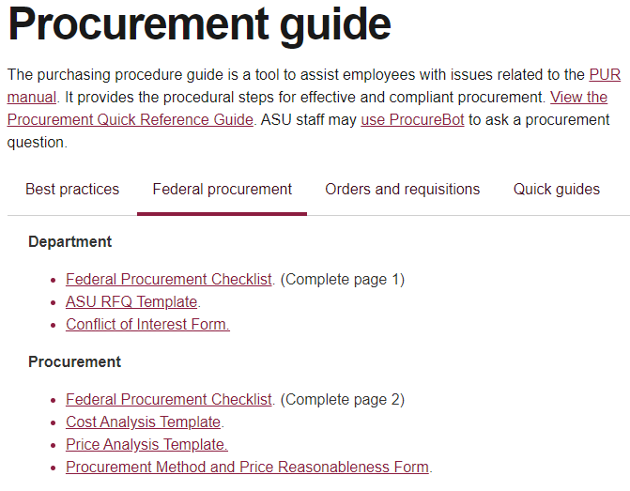
Federal Procurement
Forms Required for Purchases over $25,000
Federal Procurement Checklist
Page 1 is for Department use
Page 2 is for Procurement use
Price Reasonableness Form
Procurement to fill out
Conflict of Interest Form
Supplier to fill out, inadequate competition
Cost Analysis Form
Supplier to fill out, inadequate competition
If supplier is “named”:
Copy of grant notice of award
Copy of proposal or budget justification
with supplier named & highlighted
“Federal Procurement” tab has tools & forms: https://cfo.asu.edu/procurement-guide
Notes:
For federal purchases the department has to complete pg1 of the checklist. Check all boxes that represents steps taken for the purchase
When there is inadequate competition (ie only one quote), we need the supplier to complete the COI and CA forms
Please make sure if the supplier is “named” that they are clearly highlighted within the budget justification

Slide 9
Thinking through a purchase
Three questions:
What am I buying?
2. How am I justifying the competition?
3. How are we agreeing to the purchase?
These questions help guide you to next steps while meeting requirements.
Notes:
Goods vs. Services—Goods are objects and services are activities.
Competition: Are there other suppliers in the market that can provide similar goods or services? If so, we need at least one additional quote to determine that the price is fair and reasonable.
How are we agreeing – Use of PO as the “contract”, pcard, existing agreement (such as an RFP or MSA)

Slide 10
Purchase Orders & Contracts
The purchase order is the preferred contracting method.
01
Fast
Fastest way to agree to buy something. No negotiation required.
02
Flexible
Simple change orders can be done to modify the agreement. No amendment needed.
03
Easy
Requires clicks rather than redlines.
04
Favorable Terms
Contains everything we need in an agreement and allows us to terminate as we see fit.
05
Easy for Customers(you!)
You can see where it is in the process.
Notes:
Purchase Orders reference our Terms and Conditions via a link. These terms have already been established and meet all of our State/Federal requirements for purchases.

Slide 11
Purchase Orders & Contracts
Negotiating contracts is not a preferred approach.
01
Can be slower
It takes time to review/redline agreements.
02
Less Flexible
Require amendments, reviews, extensions, manual signatures, etc.
03
Not as easy
Whether it’s our agreement or the supplier’s, this necessitates back/forth. And occasionally counsel involvement.
04
Less FavorableTerms
In many cases suppliers want more rigid termination requirements or ASU to take on risk that they don’t want.
05
Risk
When we deviate from our standard terms & conditions, opportunities for risk arise.

Slide 12
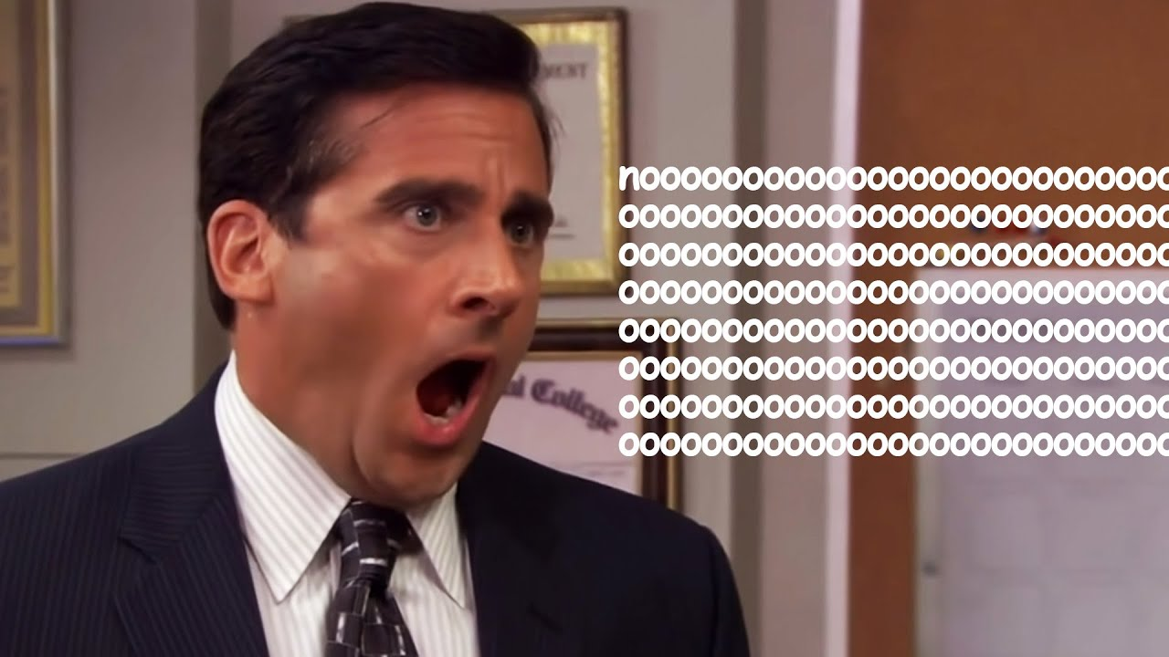
When suppliers don’t just want a PO
Try a simple explanation:
Present as our standard practice
Purchase orders legally/financially binds us to the purchase
Purchase orders are signed so that we don’t have to stop to sign agreements
Signature authority is tightly controlled, which is why the PO carries Deputy CPO’s signature
ASU is a public entity, so the state requires we include certain provisions in our agreements
Why do we need to sign a contract when the PO is a signed contract?
In many cases we can explain away the supplier’s concern.
Notes:
ASU's standard practice is to avoid negotiating/signing supplier documents and to use the PO itself as the “contract” whenever possible. The signed PO binds us to the purchase, in addition to standing as our signature for the supplier’s records. Before sending an agreement to Purchasing it’s always a good idea to check if the supplier is willing to accept the PO without a separately signed agreement.

Slide 13
Procurement in Practice
Signature Authority
The Rule(s)
Only the President has signature authority, unless it’s been delegated.
Signature authority is baked into the PO process.
Failure to follow policy could result in personal liability.
What the Rule(s) mean
Very few people can sign things.
OGC maintains the policy: https://ogc.asu.edu/contracts/contracts-authority
Follow the policy and worry about nothing. If you’re stuck, just ask.
Notes:
Buyers are delegated signature authority
Generally if there are any legal T&C’s, then the agreement should be signed by Purchasing
Please don’t sign things you aren’t sure about (or especially if you don’t have signature authority) – you could be held personally liable

Slide 14
Procurement in Practice
Pcard
Why
Great for Hotels and Stuff (goods)
Some suppliers only accept credit cards and don’t have a mechanism for a PO
Common in the marketplace, convenient and quick
Why not
Services (tax reporting)
Doesn’t include standard terms & conditions
Lack recourse in the event of an issue
Notes:
Services from non-incorporated company/individual is restricted. So it’s a burden on the cardholder to validate that. Also, Pcard doesn’t have Ts&Cs. If you’re purchasing a good/item/equipment there is generally a return/warranty policy.

Slide 15
Procurement in Practice
Our Goal is to get to Yes.
1. Consider the procurement method.
Look at the total dollar value and apply the thresholds
Check Sunmart, SunRise or State of Arizona.
If you’re just not sure, we can help.
2. Enter a requisition.
Attach w/supporting documents.
It helps us work through the purchase with you.
Communicate with us.
If it’s urgent we can try to prioritize.
If you have a question, ask us.
If you have a concern, tell us.
Notes:
It’s always best to involve us early if you have questions or concerns about a purchase

Slide 16
Questions?
Notes:
General email: purch-q@asu.edu

